Slide 1

Which city is easier to find a Chinese Restaurant
Peer-graded Assignment: Capstone Project - The Battle of Neighborhoods (Week 2)

Slide 2
My trip plan to USA
New York, NY
San Francisco, CA
Jersey City, NJ
Boston, MA
Chicago, IL

Slide 3
A question: which city is easier to find a Chinese Restaurant
Today, I want to use some of the data science knowledge I learned on Coursera, and use Python to solve a Chinese person going to the United States. Which city is easier to find a Chinese restaurant? Let’s say if you are a Chinese and have never been to the US. The first question that you may wonder is which city maybe easy to find a Chinese Restaurant while you are there. So you want to go to a place with a high density of Chinese Restaurants around there. The solution is to analyze the locations of Chinese Restaurants in a few major US cities and find the best city which can easily find a good Chinese Restaurant.
Also this solution could be a good reference for any tourists with a taste of eastern-style food. This final project explores the locations for Chinese restaurants throughout New York, Chicago, San Francisco, Jersery City and Boston, all are very famous tourism cities and also many Chinese residents. The project will attempt to answer the questions “Which city is more easy to find a Chinese Restaurant?"

Slide 4
Solution with Four Square API
By exploring Chinese Restaurant locations in the five major US cities with the Four Square API through the explore endpoint to find all Chinese Restaurant venues info. The near function query is used to get venues in these cities, and also using the CategoryID to fillter out only Chinese Restaurant.
In the end, to calculate indicator of the density of Chinese Restaurants, the project calculated a center coordinate of the venues to get the mean longitude and latitude values. Then the mean of Euclidean distance from each venue to the mean coordinates is calculated, these indicator: mean distance to the mean coordinate, will tell which city has the highest density, so that we will know it suppose to be easier to find a Chinese Restaurant.

Slide 5
New York has 237 Chinese Restaurants
City | Counts of Restaurants
New York | 237
San Franciscoo | 236
Chicago | 230
Boston | 192
Jersey City | 157

Slide 6
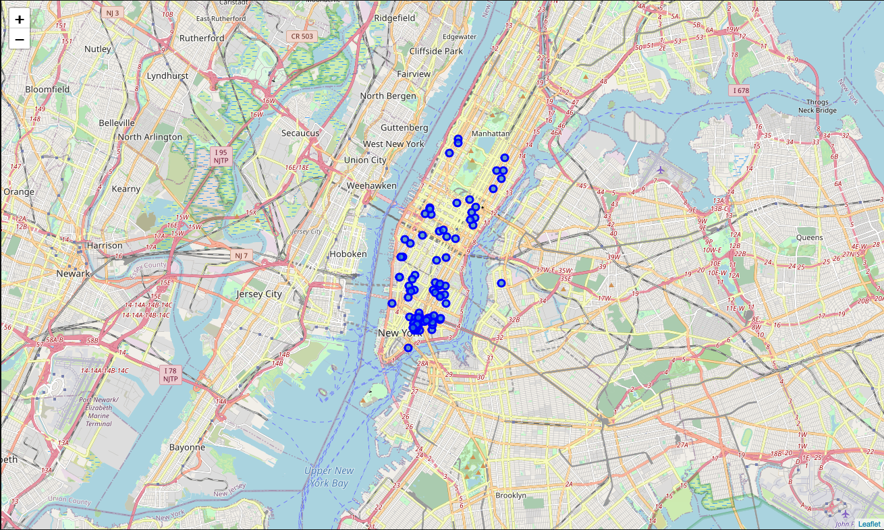
New York

Slide 7
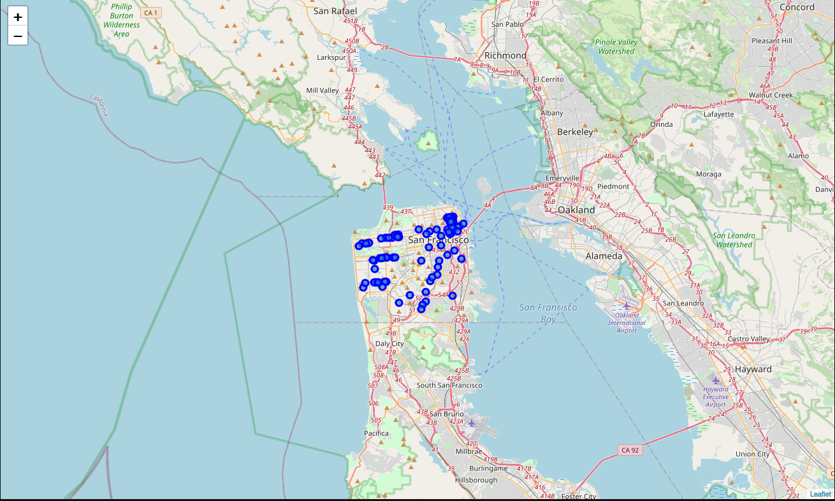
San Francisco

Slide 8
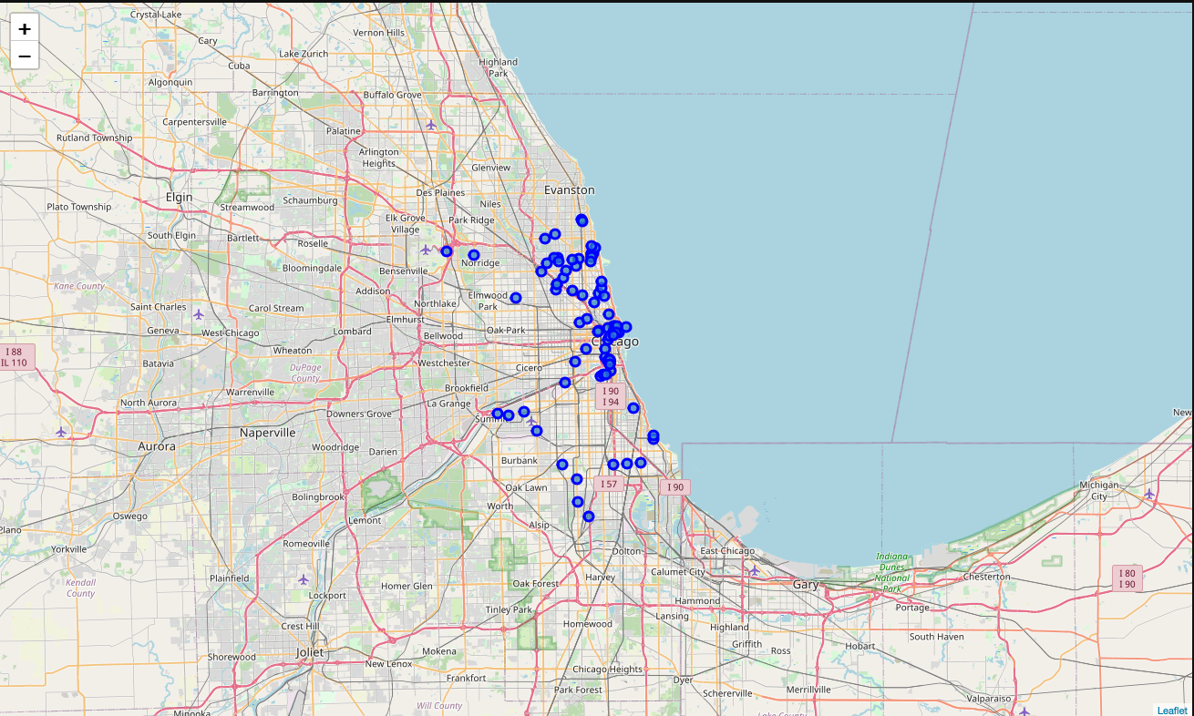
Chicago

Slide 9
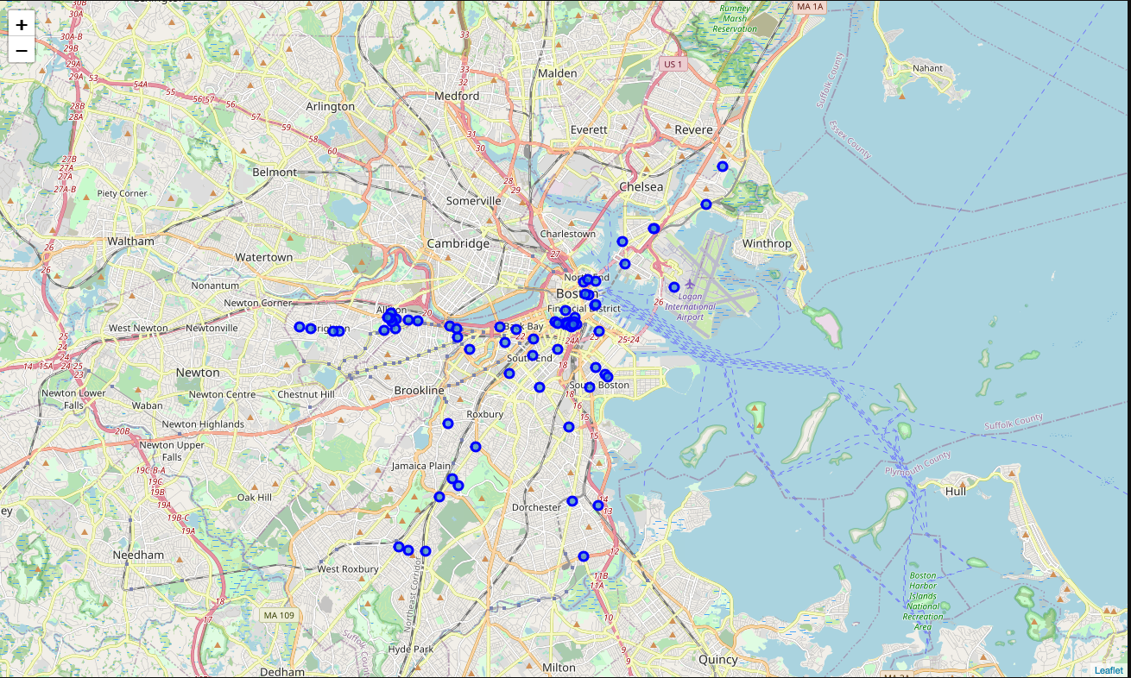
Boston

Slide 10
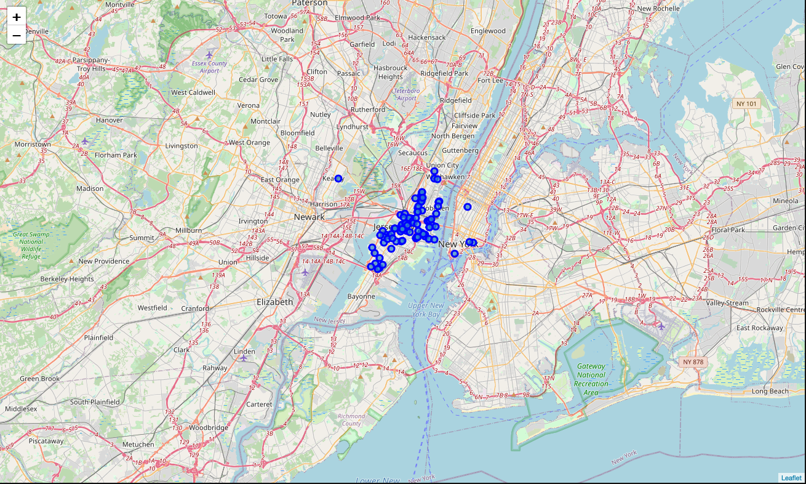
Jersy City

Slide 11
Very close numbers in NY/SFO/CHI
It's a little bit hard to tell which city will be easy to find a Chinese Restaurant in mean distance or time. So let's have a concrete measure of this density. For this I will use some basic statistics. I will get the mean location of the Chinese Restaurant places which should be near to most of them if they are really dense or far if not. Upon First inspection we see that New York, Jersey City and San Francisco are the most densely cities. In the next phase we Calculate the Mean coordinate and the mean distance to mean coordinate(MDMC). We represent the mean coordinate with a big green circle and distances with green lines. One consideration to do further work on is to move the location of the Foursquare API query until we get all the places in each city and do the calculations again.

Slide 12
Reranked by density (average of the distance of the venues to the mean coordinates)
city | means
Jersey City | 0.015277
New York | 0.020803
San Francisco | 0.026842
Boston | 0.028492
Chicago | 0.045421

Slide 13
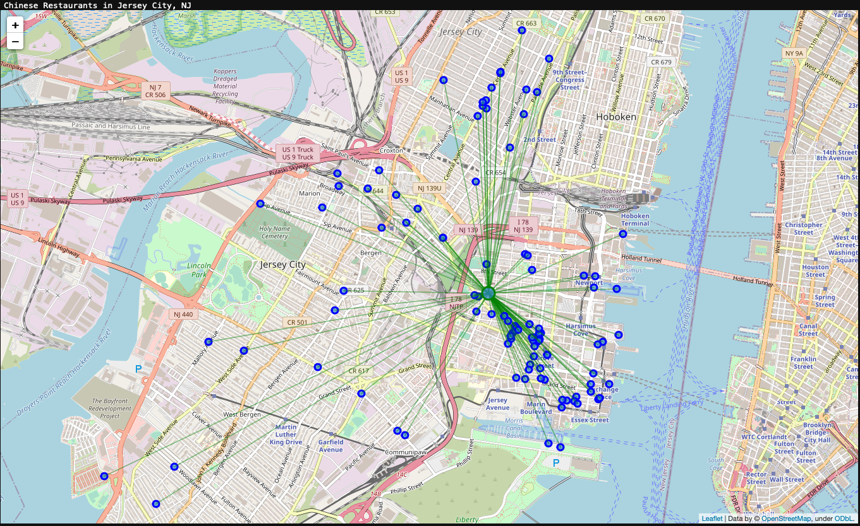
Jersy City

Slide 14
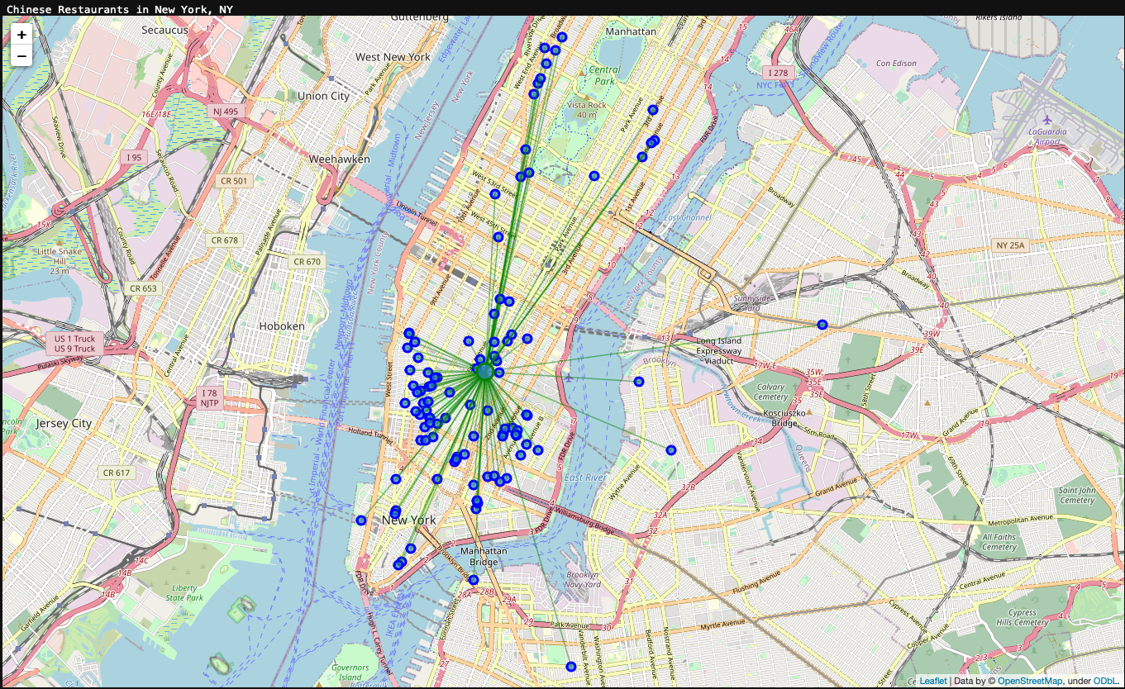
New York

Slide 15
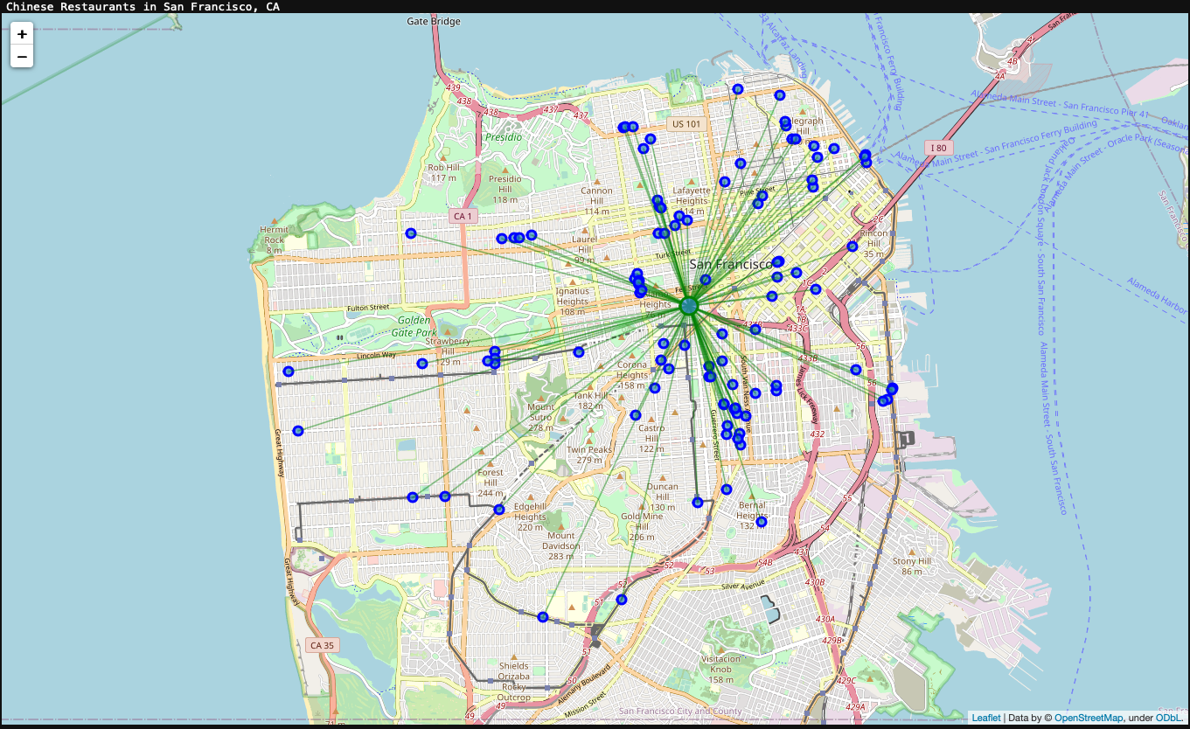
San Francisco

Slide 16
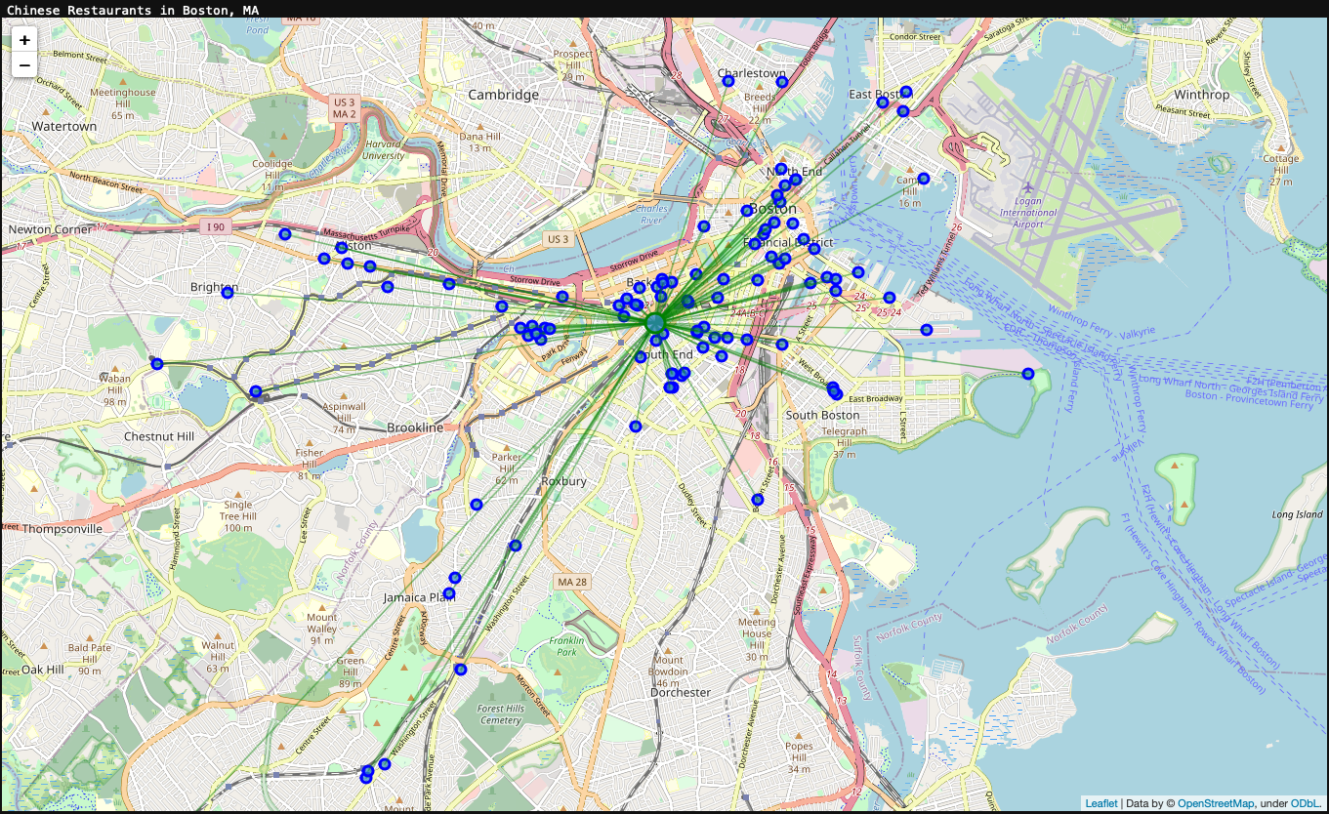
Boston

Slide 17
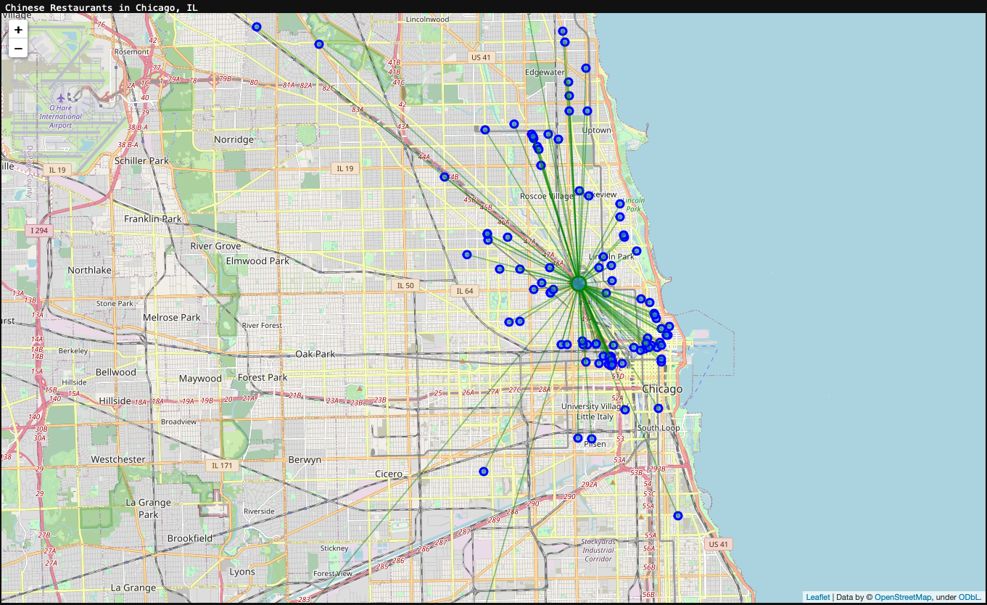
Chicago

Slide 18
Conclusion
New York is best place to find Chinese Restaurants not only because it has the most numbers but also because it’s close to Jersy City for another more than 200 ones.
Even though NY/SFO/CHI has similar numbers of Chinese Restaurants, but because the average distance difference may make tourist have very different experience while trying to find a good Chinese Restaurant.

